Slide 1
Notes:
THE MPI FOUNDATION IS MPI’S CHARITY OF CHOICE.
OUR MISSION IS TO HELP ADVANCE THE DEVELOPMENT OF OUR MEMBERS AND OUR INDUSTRY…

Slide 2
CELEBRATING THE POWER OF GOOD…
Notes:
AND IN THE BLINK OF AN EYE, MPIF HAS BEEN SERVING OTHERS FOR 40 YEARS!
WHAT DOES THAT MEAN FOR OUR COMMUNITY?

Slide 3
Community Impact Since 2020
$1.8MM • 3,800 individuals • 63 Chapters
• 4 Major Grants
Community Impact Since 1984
$14.4 MM
Notes:
RECENTLY, WHEN THE PANDEMIC HIT, THE MPI FOUNDATION REMAINED FOCUSED ON ENSURING WE SUPPORT OUR GLOBAL INDUSTRY AND OUR MEMBERS. SOME OF YOU MAY HAVE BEEN DIRECTLY SUPPORTED.
DURING THAT TIME, MPIF SURPASSED $1.8MM IN DISTRIBUTIONS.
SINCE ITS ORIGINATION, OVER $14.4 MM HAS BEEN DISTRIBUTED… WHICH ONLY GROWS OUR IMPACT

Slide 4
$30,000 Awarded
Notes:
IT’S NOT JUST MEMBERSHIP SUPPORT…
IN 2023, MPIF SUBSIDIZED 30 UKRANIAN HOSPITALITY STUDENTS TUITION ALLOWING THEM TO GRADUATE AND ENTER OUR WORKFORCE…

Slide 5
2023
$13,000 Awarded
Notes:
MPIF ALSO PROVIDES FUNDS TO CHAPTERS TO PROVIDE EDUCATION LOCALLY…
ABOUT IDENTIFYING AND ENDING HUMAN TRAFFICKING…

Slide 6
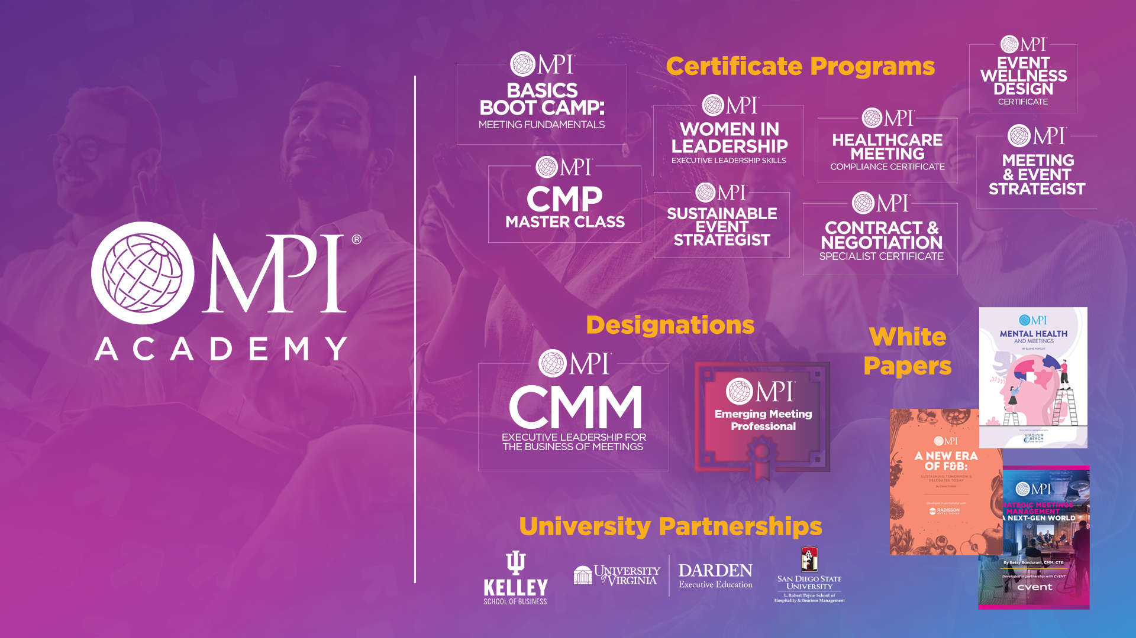
Provide Scholarships for
Professional Development
Advancing Our
Industry by Strengthening its People
Notes:
MPIF ALSO SUBSIDIZES GRANTS & SCHOLARSHIPS TO OUR MEMBERS…
SO THEY CAN CONTINUE TO PURSUE EDUCATION AND ENHANCE THEIR PROFESSIONAL STANDING…

Slide 7
Do You or Your Chapter
Need Support?
Notes:
LET’S START WITH YOU…
DO YOU NEED ASSISTANCE AND WHERE DO YOU GO TO GET HELP?

Slide 8
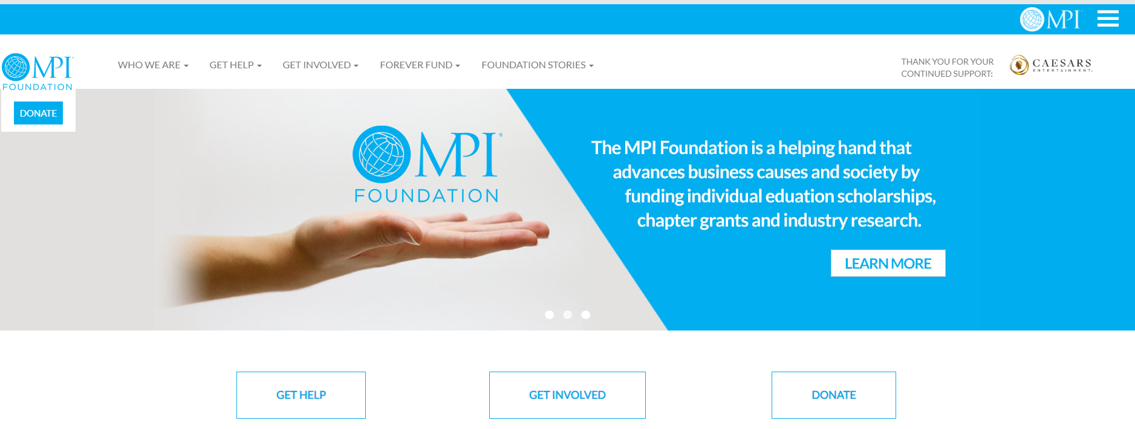
www.mpifoundation.org
Notes:
VISIT THE MPI FOUNDATION WEBSITE AND CLIK ON THE “GET HELP” BUTTON TO PREVIEW GRANTS AND SCHOLARSHIPS THAT ARE CURRENTLY AVAILABLE…

Slide 9
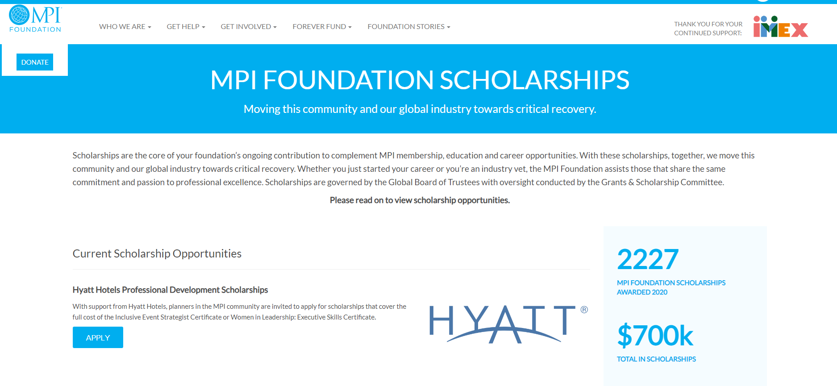
Updates happen frequently…
Notes:
…AND CHECK FREQUENTLY, AS MPIF HAS DIFFERENT PARTNERS THAT MAKE DONATIONS TO SUPPORT DIVERSE EFFORTS…

Slide 10
Financial Impact
Notes:
THIS IS ALL GREAT, JASON… BUT WHAT DOES THIS LOOK LIKE FINANCIALLY…?

Slide 11
2015 – 2023 (9 years)
Avg. 139 Members
Funds raised: $1,164
MPIF distributions: $39,582
60 Scholarships
4 Grants
Notes:
WELL IN THE LAST 9 YEARS, MPI GULF STATES HAS BEEN THE BENEFICIARY OF ALMOST $39,000 THROUGH SCHOLARSHIPS TO LOCAL MEMBERS AND CHAPTER GRANTS…
CONVERSELY, THE CHAPTER HAS DONATED ABOUT $1,100 OVER THOSE 9 YEARS.
I SHARE THIS BECAUSE MPIF IS NOT A BANK AND ISN’T LOOKING FOR AN ROI. BUT IT DOES NEED YOUR SUPPORT.

Slide 12
Ways to Support MPIF
Notes:
SO HOW CAN YOU DONATE TO MPIF?

Slide 13
Chapter Landing Page | Donate Button
Notes:
24/7 VIA THE GULF STATES WEBSITE…
JUST CLICK ON THE DONATE BUTTON…

Slide 14
Updates
All Chapter Contribution Program
Examples of how chapters can contribute:
$2 registration fee applied to all chapter events
5% of all other charitable funds raised are given to Foundation
Host 1 or more dedicated fundraising event
Live and/or silent auction proceeds of a __% of total revenues
Notes:
AS A CHAPTER, SIGN A PLEDGE TO DONATE A PORTION OF YOUR EVENT FEES OR CREATE AN EVENT SOLELY FOR MPIF…

Slide 15
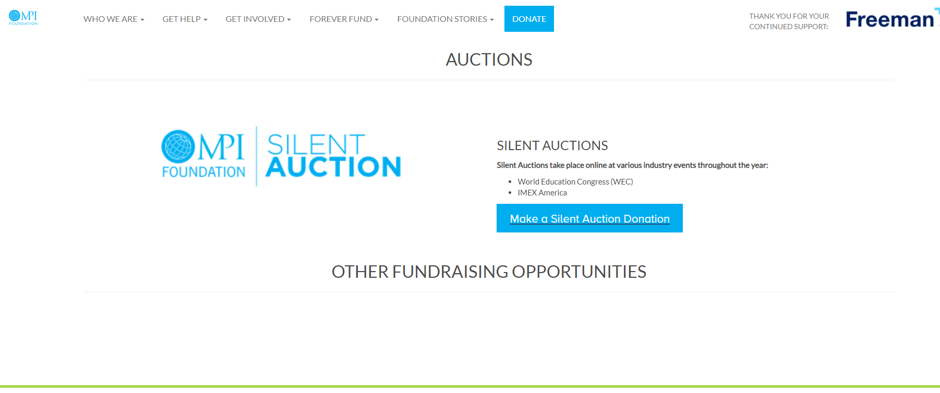
www.mpifoundation.org
Notes:
AS A CHAPTER, CONTRIBUTE AN AUCITON ITEM TO BE USED THROUGHOUT ANY YEAR

Slide 16
Notes:
…LIKE THE MAJOR SILENT AUCTION THAT HAPPENS DURING IMEX AMERICA…
AND FEEL FREE TO BID ON SOME GREAT PACKAGES!!!

Slide 17
YOU
Notes:
THIS ALL STARTS AND ENDS WITH YOU.
HELP US CELEBRATE THE POWER OF GOOD BY SUPPORTING THE MPI FOUNDATION…
THANK YOU!

