Slide 1
PRESENTED BY: Insert Presenter
Insert Term Dates

Slide 2
TABLE OF CONTENTS
General Responsibilities of Board Participation
 Legal Responsibilities of Board Participation
 Using the Chapter Leadership Resources on www.mpiweb.org
 Policies & Procedures Overview
Chapter Calendar
 Association Management Overview
 Overview of Vision & Goals for (insert term)

Slide 3
BOARD RESPONSIBILITIES
3

Slide 4
and share it with the committee
 Understand the chapter’s budget
 Review the monthly financial reports, question any discrepancies, confirm with committee
 Ensure important documents are shared and confirm accuracy for the business plan, sponsorship tracking updates, etc.
BOARD LIAISON RESPONSIBILITIES

Slide 5
 Ensure monthly committee reports are submitted and accurate
 Discuss board decisions with committee that impact their event/initiative
 Bring important committee discussions to the board that require board consideration or approval
BOARD RESPONSIBILITIES

Slide 6
MONTHLY BOARD MEETINGS DOCUMENTS
 Board Reports
Action - Prepare as required by chapter and submit by
assigned deadlines
 Board Meeting Agenda
Action - Read through in advance. E-mail or call your VP if you need any items added to the agenda in your particular area.
 Committee Reports - Committee communication that reports activities for the previous month
Action - Read each report thoroughly prior to our meeting.
Call the Director of a committee if you have a question
about the report.

Slide 7
 Previous Month’s Financials -Historical report of the expenses and revenue accrued by the Chapter, and a forecast for expenses and revenue for upcoming Chapter endeavors.
Action - Review each page for any large (+) or (-) in any category and make note. Look at your budget areas and if you feel there are inaccuracies in either reporting or forecasting in a particular area, call VP of Finance. Any changes to the budget require a Motion to the Board.
MONTHLY BOARD MEETINGS DOCUMENTS
7

Slide 8
 Board Meeting Motions - These are changes to the
Chapter’s Policies & Procedures.
Action - Read through in advance. Approach the Director with questions in advance so they may include their answer in a presentation, saving time.
 Sponsorship Tracking Report - Status of confirmed sponsorships and the value of those sponsorships
Action - Read through the report and make note of any sponsors you could personally thank on behalf of the Chapter at the next event you attend.
MONTHLY BOARD MEETINGS DOCUMENTS
8

Slide 9
Questions?
QUESTIONS?
9

Slide 10
Legal Responsibilities
LEGAL RESPONSIBILITIES
10

Slide 11
MPI Mission:
MPI VISION: BUILD A RICH GLOBAL MEETING INDUSTRY COMMUNITY
Make our members successful by building human connections to:
Knowledge/Ideas
Relationships
Marketplaces
The Vision is delivered by four
strategies:
 Evolve to a global community
 Re-imagine our business relationship with chapters
 Elevate the member conversation and experience
 Build a great organization

Slide 12
ASSOCIATIONS ARE UNIQUE
The same group of people are the:
Owners
Customers
Workforce

Slide 13
BASIC RESPONSIBILITIES OF BOARDS
 Determine and advance mission & values
 Manage organization’s resources
 Disclose conflicts of interest
 Maintain confidentiality
 Be informed
 Determine and monitor programs & services
 Enhance image & promote organization
 Select, support and review management
 Assess performance

Slide 14
LEGAL DUTIES OF BOARD SERVICE
Duty of Care
Duty of Loyalty
Duty of Obedience

Slide 15
LEGAL DUTIES
 Duty of Care
 Attaches to you personally
 Protect confidential information
 Responsible to entire membership
 Be informed; participate; understand
 Informed and independent judgment
 Duty continues indefinitely

Slide 16
LEGAL DUTIES
 Duty of Loyalty
 Speaks to situation at hand
 Association comes first
 Personal gain; Conflict of interest
 Best interests of organization
 Can do work or supply services
IF fair process
No appearance of impropriety
 Otherwise STEP ASIDE

Slide 17
LEGAL DUTIES
Duty of Obedience
 Applies to group as a whole
 Follow laws, policies, rules
 Engage in debate; participate
 Speak with one voice; united front
 Do not speak poorly of decisions
 Believe in the process
 Trouble can be co$$$tly

Slide 18
CONFLICT OF INTEREST - “COI”
 REQUIREMENTS:
 Honesty and DISCLOSURE OPTIONS:
 Excusal from discussion
 Excusal from deliberation
 Excusal from decision
 Whichever chosen, document in minutes
 Last resort: Resignation

Slide 19
LIABILITY OF DIRECTORS
 Breach of fiduciary duties
 Disregard of duties to the organization
 Third party claims
 Harm caused to another
 Statutory liability
 Anti-trust, discrimination

Slide 20
MINIMIZE RISK
 Insurance
 Duty of Care - Use good judgment; due
diligence in decisions
 Loyalty - Avoid conflicts of interest & personal
gain; “best interests”
 Obedience - Faithful to mission; follow governing documents

Slide 21
HIERARCHY OF DOCUMENTATION
National and local laws
Articles of Incorporation - Contract with the state
Nonprofit status from IRS
Bylaws | Contract with our members
Policies & Procedures| Contract with ourselves

Slide 22
NONPROFIT STATUS – 501(C)(3)
 Is a tax status, not a way of doing business
 Educational or scientific
 Contributions usually deductible
 Very limited lobbying allowed
 Cannot be involved in political campaign
 Exempt from federal income tax (with
exceptions)
 Not-for-profit does not mean NO profit
 NO MONEY, NO MISSION!!!

Slide 23
WHAT ABOUT COMMITTEES?
 Committees’ Role
 Extend the work of the board
 Provide regular reports
 Recruit and plan for future leadership
 Board Liaison Role
 SHARE information
 SUPPORT activities
 Look out for the WHOLE

Slide 24
BOARD IN ACTION
 No individual authority as board members
 All authority belongs to the board as a whole when acting as a group
 No speaking on behalf of organization without authorization
 Board should deal with issues affecting the
WHOLE organization, not individuals

Slide 25
BOARD MEETINGS
 Attendance – quorum
 In person, conference call, e-mail vote
 Decisions belong to the whole board
 Motions belong to the board
 Robert’s Rules of Order
 “ I move that…” or “I move to…”
 Responsible even if absent or not voting
 Abstention = non participating in vote

Slide 26
EFFECTIVE BOARD LEADERSHIP
Support the board and the mission
Manage resources Communicate respectfully Maintain confidentiality Avoid conflicts of interest

Slide 27
SPECIFIC BOARD RESPONSIBILITIES
 Read all about it!
Refer to your Job Description


Slide 28
Be There
Show Up
Attend
THE THREE MOST IMPORTANT THINGS?

Slide 29
Questions
QUESTIONS?
29

Slide 30
LEADERS COMMUNITY ON MPIWEB.ORG
 How to find it:
 Visit www.mpiweb.org
 Log in
 Select Chapter Leaders

Slide 31
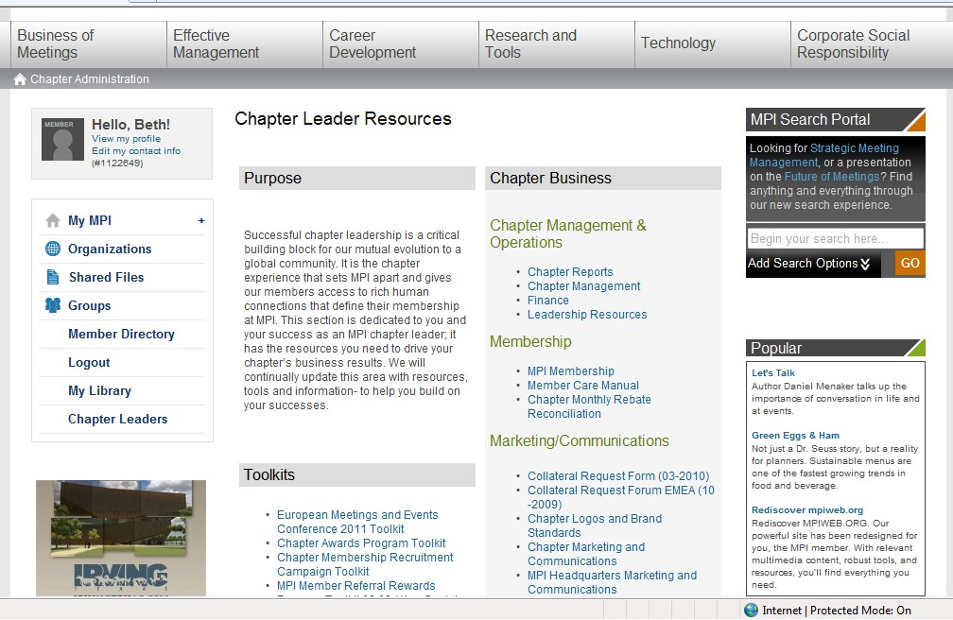

Slide 32
MPI CHAPTER LEADER COMMUNITY
 Chapter Management & Operations
 Chapter Reports | Membership Reports w/ renewals, reinstates & dropped member info
 Chapter Management
Includes a MILLION cool things. Robert’s Rules, Chapter Document Templates, Tradeshow Equipment Request Link, Collateral Request Link, CEU Guidelines & Tracking Form, and How To and Samples for building new forms!
 Finance | Chapter Best Practices, Grants Application Forms, Investment Policies, etc.
 Leadership Resources | Leadership Newsletters & Chapter Leaders Conference Info
 Marketing/Communications
 Chapter Logos and Brand Standards
 Chapter Marketing Communications | Marketing Plan Sample, Newsletter Templates, Website Template
 MPI Headquarters Marketing and Communications | Web Banner Ads, HTML email templates
 Membership
 MPI Membership
 Member Care Manual
 Chapter Monthly Rebate Reconciliation

Slide 33
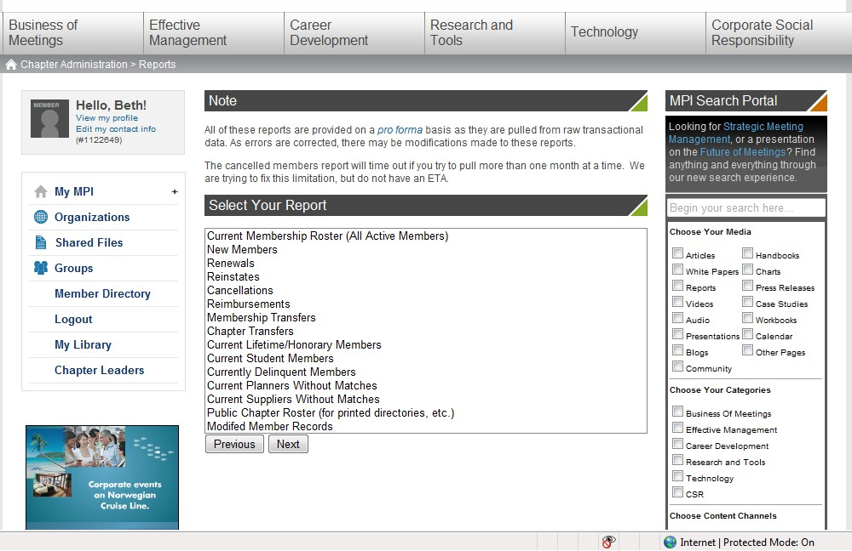

Slide 34
MPI CHAPTER LEADER COMMUNITY
 Education & Programming Resources
 Chapter Content Database
 Leadership Role Training Webinars
 Global Industry Events Calendar
 Certified Meeting Management (CMM)
 Certified Meeting Professionals (CMP)
 Grant and Foundation Information
 Chapter Liaison Resources
 Chapter Grant Application & Grant Evaluation
 Samples of Approved Chapter Grants
 MPI Key Information
 MPI Vision/Mission Statement and Core Values
 Chapter Minimum Bylaws (June 2009) & MPI Bylaws (Rev. November 2008)
 MPI Policy Manual (Rev. February 2009)
 Chapter Code of Ethics
 MPI and Industry Acronyms
 Buy MPI Template

Slide 35
(INSERT NAME)CHAPTER WEBSITE
 How to find it:
 Visit (enter chapter site)
 Log in

Slide 36
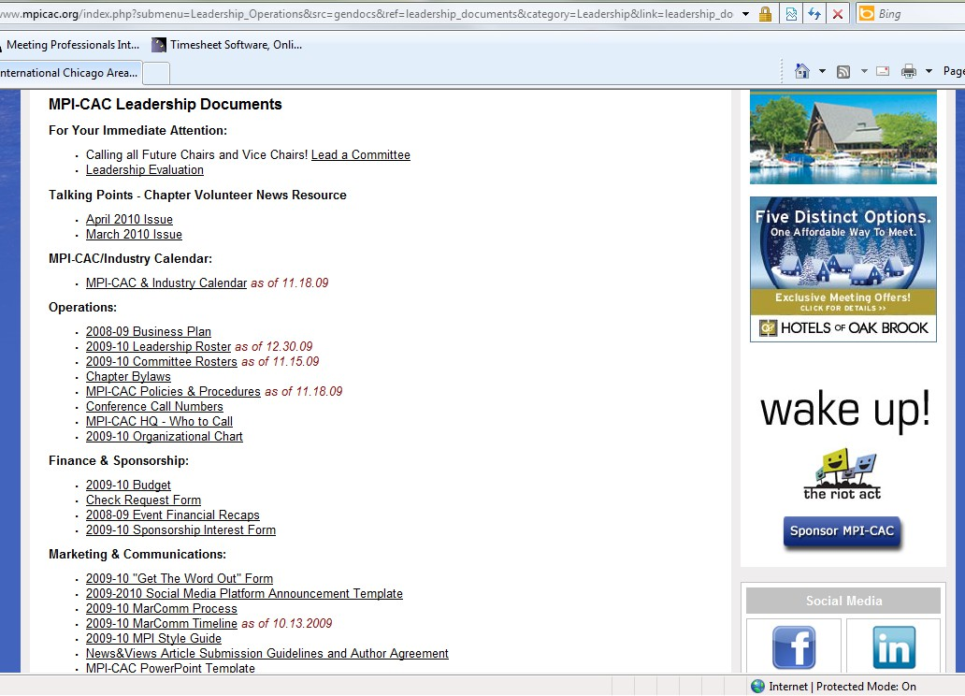

Slide 37
CHAPTER LEADER TOOLS
 For Your Immediate Attention:
 links to current, relevant documents/forms
 Talking Points - Chapter Volunteer News Resource
 past issues of the new Chapter Volunteer eNewsletter
 Operations
 Industry Calendar
 Business Plan
 Leadership Roster
 Committee Rosters
 Chapter Bylaws
 Policies & Procedures
 Conference Call Numbers
 Who to Call
 Board of Directors Organizational Charts

Slide 38
CHAPTER LEADER TOOLS
 Finance & Sponsorship
 Budget
 Check Request Form
 Past Event Financial Recaps
 Sponsorship Interest Form
 Marketing & Communications
 "Get The Word Out" Form
 Social Media Platform Announcement Template
 MarComm Process
 MarComm Timeline
 MPI Style Guide
 Newsletters Article Submission Guidelines and Author
Agreement

Slide 39
CHAPTER LEADER TOOLS
 Event History & Logistics
 Standard Event History/RFP Template
 Onsite Registration Requirements
 Event Registration Statistics
 Leadership Tools
 Committee Agenda Template
 Committee Minutes Template
 Committee Monthly Report Template
 Committee Roster Template
 Committee Acceptance Form
 Committee Transition Checklist

Slide 40
Questions?
QUESTIONS?
40

Slide 41
POLICIES & PROCEDURES QUICK OVERVIEW

Slide 42
THE BASICS
 Every chapter leader should review the
entire document (it’s a quick read!)
 Each chair should be very familiar with their section
 Chapter operational forms are included in the Appendix – note that the most recent updates are to be found on the Chapter Website

Slide 43
BOARD AND COMMITTEE MEETINGS
 Meeting Logistics
 Every board or committee meeting should have an agenda
 Minutes must be recorded for each meeting
 Committee chairs should send a Monthly Board report to their
board liaison and HQ detailing the previous month’s activities

Slide 44
POLICIES & PROCEDURES CHANGES
 Any changes to the P&P’s must be presented to the Board thru the Board Liaison
 Present the change as a written motion
for a vote
 Discussion points will be expected to support the suggested change

Slide 45
BUDGET & FINANCE
 Check Requests
 Each expense incurred must be documented on
the “Check Request” form
 Submit form with copy of invoice to the committee chair for Board Liaison approval
 Checks are cut twice per month – ensure the vendor is aware of a potential lag time with receiving payment
 No payment will be made without an invoice or Check Request form
 All unbudgeted expenses must be approved by
the board

Slide 46
 All committees shall solicit a minimum of three bids for any event items that will be purchased with chapter monies or for sponsorships (cash or in-kind)
 Solicitation of Bids
 Contracts
 All contracts are to be signed by the
chapter president
 The chapter’s headquarters office must
be listed as the contact location
BUDGET & FINANCE

Slide 47
Questions?
QUESTIONS?
47

Slide 48
SPONSORSHIP PROCESS
Submit the Committee’s sponsorship needs to the Chapter
Management Office thru the Budget Template.
Create and distribute the Request for Donations (RFD) for sponsorship needs and solicit minimum of three (3) providers.
The selected sponsor must complete the Sponsorship Interest Form.
Set the sponsors’ expectation of the maximum sponsorship level
they can achieve based on the Sponsorship Caps.
Negotiating Pre-Determined Benefits – If a sponsor is asking to negotiate the standard benefits, work with the Director of Sponsorship to determine acceptable changes to the standard benefits package.

Slide 49
SPONSORSHIP PROCESS (CONT.)
Dir. Of Sponsorship and/or Management Office create Sponsorship Agreement.
Cash sponsors should receive an invoice with the sponsorship agreement.
Sponsors must submit their signed agreements to the Chapter Management Office.
A Sponsorship Kit will be emailed by the Chapter Management Office after receiving the signed agreement.
Committees to communicate with the sponsor on fulfilling event specific benefits.

Slide 50
Questions?
QUESTIONS?
50

Slide 51
CALENDAR OVERVIEW
 Chapter Important Dates
 Chapter chapter events
 Chapter board meetings
 Publication dates (example every other Tuesday)
 MPI Conferences
 Industry Events & Tradeshows
 Major Holidays

Slide 52
Questions?
QUESTIONS?
52

Slide 53
MEET YOUR ASSOCIATION MANAGER
 – Executive Director
 – Association Manager
 – Sr. Financial Accountant
 – Staff Accountant
 – Graphic Designer
 – President
 – Chief Operating Officer
 – Vice President

Slide 54
MAIN CONTACT INFORMATION
Executive Director -
Association Manager -

Slide 55
TEAM ROLES & RESPONSIBILITIES
Executive Director –
General Management
 Leads Association Management Team
 Manages all pace reporting activities and board reporting
 Serves as liaison to MPI headquarters
Communications
 Manages non-event based website content updates and
changes
 Serves as Editor for online and print publications
Sponsorship & Advertising
 Manages sponsorship agreements and benefit fulfillment for all
chapter sponsors
 Advertising sales for online and print publications

Slide 56
TEAM ROLES & RESPONSIBILITIES
Executive Director –
Strategic Guidance
 Conducts consistent benchmarking studies while providing
recommendations for best practices
 Advises President, President-Elect and Board of Directors
 Advises BOD on Policies and Procedures
 Assists committees with expectations, terms and trains incoming
leadership
Finance
 Prepares post-event preliminary financial reports
 Conducts year-end financial projection analysis throughout the
fiscal year
 Works with Finance Committee to develop long-term financial
planning and revenue growth strategies

Slide 57
TEAM ROLES & RESPONSIBILITIES
Association Manager –
General Management
 Serves as chapter’s Point Person - Answers all phone calls,
responds to emails and member requests
 Interface between members, Board of Directors and Chapter
Leadership
 Support Chapter in all administrative responsibilities
Event Marketing & Logistics
 Develops and distributes all Cvent Communications based on
submitted GTWO forms and communicates directly with Cvent
on all related issues
 Assists Chapter Leadership with all events as needed

Slide 58
TEAM ROLES & RESPONSIBILITIES
Association Manager –
Membership
 Manages all Q&A, Assessments and develops tabulated membership reports
 Send initial new member communications from the Chapter
Communications
 Manages all association communications campaigns event marketing campaigns/ activities and promotional efforts.
 Ensures consistency of the Chapter’s messaging across event
and membership campaigns.

Slide 59
TEAM ROLES & RESPONSIBILITIES
Sr. Financial Accountant –
Staff Accountant –
 Manages all accounting procedures according to Policies and Procedures
 Financial Reporting (Monthly and Yearly)
 Accounts Payable and Receivable Management
 Banking and Merchant Services Management
 Manages Annual Audit

Slide 60
TEAM ROLES & RESPONSIBILITIES
Marketing/Graphic Design Manager –.
 Serves as main contact for Association Manager and Executive Director for all related Marketing and Graphic Design needs
 Produces design and layout for News & Views
 Creates graphic design for five major events including:
 Save the Date postcard
 Cvent header
 Program Guide
 Other graphical design elements as needed

Slide 61
SCOPE OF SERVICES
Strategic Guidance
Technology &
Web Site
Membership
Exec Committee &
Board Services
Association Partnership
Meeting Management
Financial Manageme nt
Communications
General & Admin

Slide 62
HOW ASSOCIATION INTERFACES WITH THE LEADERSHIP TEAM
Attendance at committee meetings
Support committee requests
 Provide suggestions and guidance
 Assist with initiative implementation
Compile wrap-up reports for historical perspectives

Slide 63
WHO TO CALL
Contact | Topic
Association Manager – | General Chapter Information
 | Membership
 | Registration & General Event Information
 | Event Websites & Registration Creation (Cvent)
 | Registration Wrap Up and Post Event Survey
Executive Director – | Web Updates
 | Sponsorships & Advertising
 | Communications
 | Accounting & Finance
 | Strategy, Benchmarking, Board Liaison Contact

Slide 64
Questions?
QUESTIONS?
64

Slide 65
CHAPTER GOALS & STRATEGIC VISION FOR (INSERT TERM)
INSERT PRESIDENT NAME

Slide 66
CHAPTER CORE VALUES
Elevate the professional development of all members
Immerse ourselves in meaningful relationships
Set an example to others and help lead the future
Help our Members build their business.
Become a part of something bigger.

Slide 67
Thank you
for all you are about to do this year!

